Slide 1

Lesson 2.1: CIRCLES Lesson 2.2 MISCELLANEOUS PLANES
Week 3 and Week 4
Math 13
Solid Mensuration
Notes:
Week 5

Slide 2
2.1 CIRCLES
A circle is a set of points, each of which is equidistant from a fixed point called the center.
The line joining the center of a circle to any points on the circle is known as the radius.
An arc is a portion of a circle that contains two endpoints and all the points on the circle between the endpoints.
Reference: Solid Mensuration by Richard Earnhart
Notes:
Week 5

Slide 3
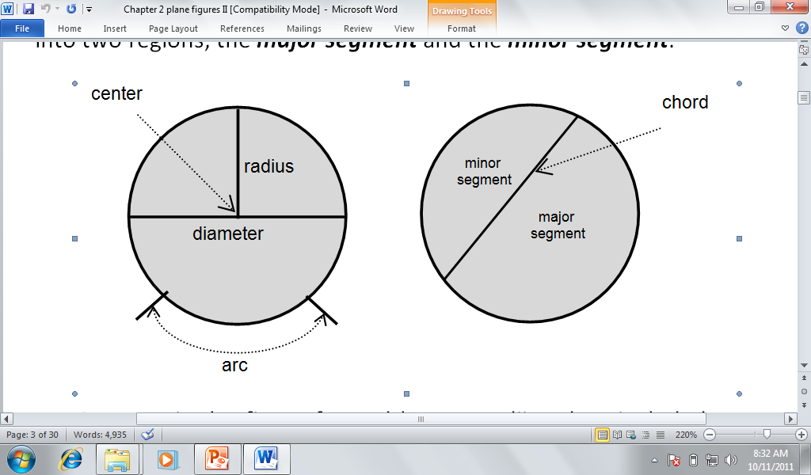
By choosing any two points on the circle, two arcs will be formed; a major arc (the longer arc), and a minor arc (the shorter one).

Slide 4
A chord is a line segment joining any two points on the circle. The chord that passes through the center of the circle is called the diameter of a circle.
A chord divides the circle into two regions, the major segment and the minor segment.
Reference: Solid Mensuration by Richard Earnhart

Slide 5
A sector is the figure formed by two radii and an included arc. The central angle is the angle in which the vertex lies at the center of the circle and which sides are the two radii.
The inscribed angle is the angle in which the vertex lies on the circle and which two sides are chords of the circle.
Reference: Solid Mensuration by Richard Earnhart

Slide 6
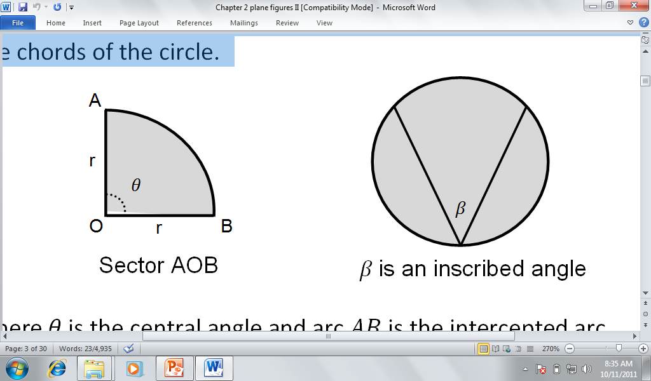

Slide 7
If circles of different radii have common center then they are referred to as concentric circles.
The region bounded by any two concentric circles is known as the annulus.
A line in the same plane as the circle is a tangent line of the circle if it intersects the circle at exactly one point on the circle.
A line is called a secant line if it intersects the circle at two points on the circle.
Reference: Solid Mensuration by Richard Earnhart

Slide 8
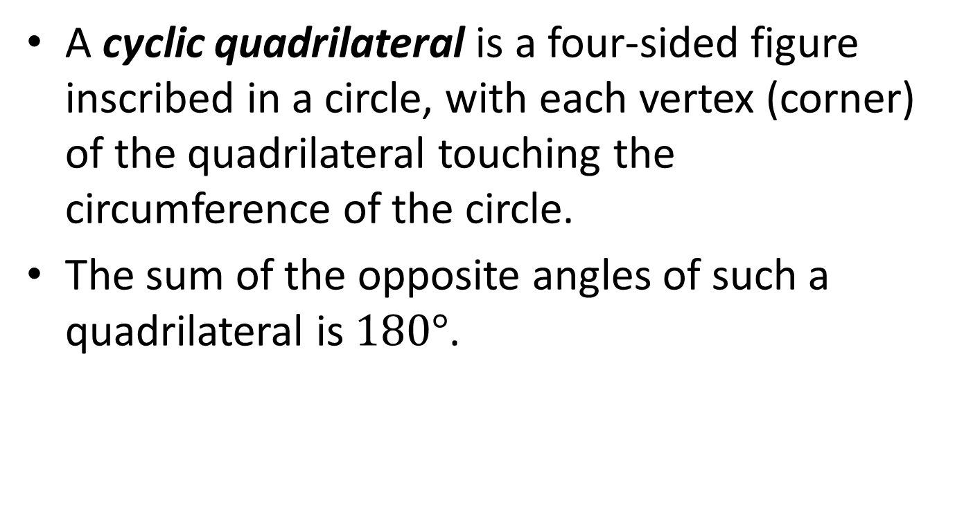
A cyclic quadrilateral is a four-sided figure inscribed in a circle, with each vertex (corner) of the quadrilateral touching the circumference of the circle.
The sum of the opposite angles of such a quadrilateral is $180°$.
Reference: Solid Mensuration by Richard Earnhart

Slide 9
Theorems on Circles
If two chords intersect at a point inside the circle, then the product of the segments of one chord is equal to the product of the segments of the other chord.
If two secant lines of a circle intersect at an exterior point, then the product of lengths of the entire secant line and its external segment is equal to the product of the lengths of the other secant line and its external segment.
Reference: Solid Mensuration by Richard Earnhart

Slide 10
If a tangent line and a secant line of a circle intersect at a point exterior to the circle, then the product of the lengths of the secant line and its external segment is equal to the square of the length of the tangent line.
Every tangent line of a circle is perpendicular to the radius of the circle drawn through the point of tangency.
Reference: Solid Mensuration by Richard Earnhart

Slide 11
The diameter that is perpendicular to a chord bisects the chord and its two arcs.
Conversely, the diameter that bisects a chord is perpendicular to the chord.
Consequently, the perpendicular bisector
of a chord is the diameter of the circle
which must pass through the center of the
circle.
Reference: Solid Mensuration by Richard Earnhart

Slide 12
The line of centers of two tangent circles passes through the point of tangency.
An inscribed angle is measured by one-half of its intercepted arc.
The angle formed by constructing lines from the ends of the diameter of a circle to a point on the circle is a right angle.
Reference: Solid Mensuration by Richard Earnhart

Slide 13
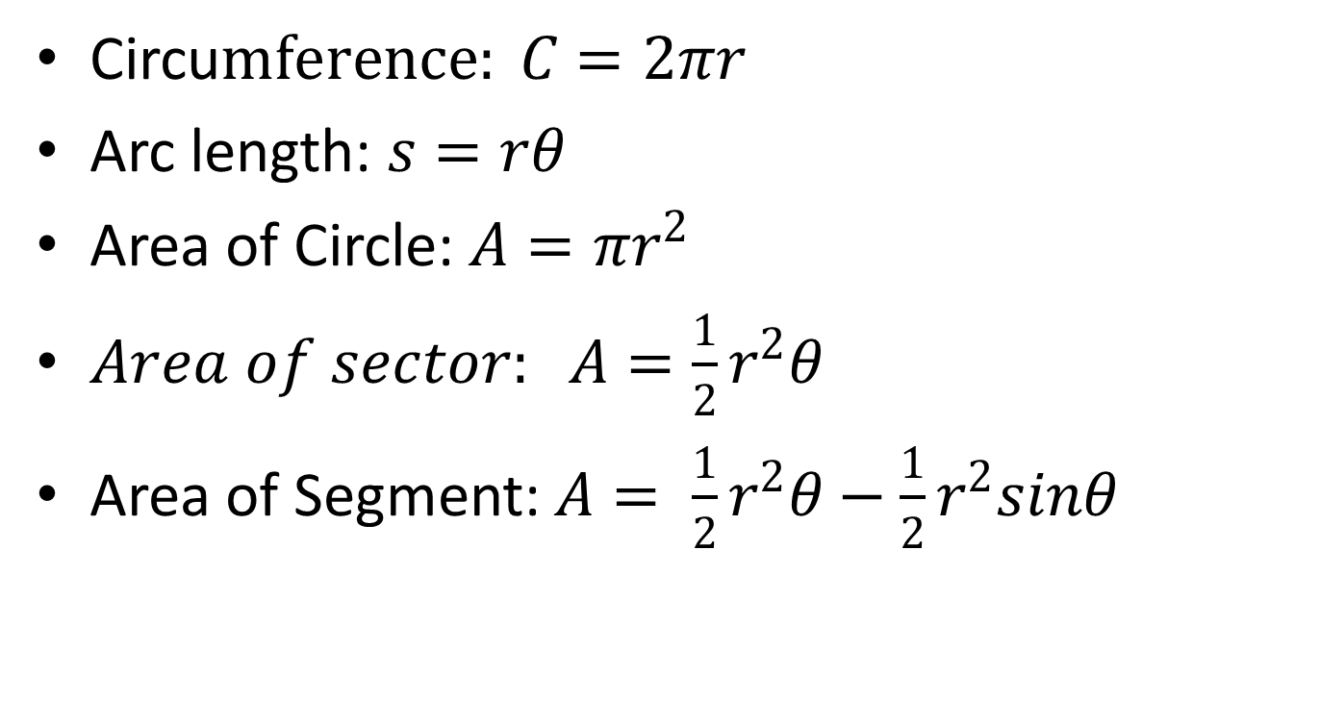
Formulas on Circles
Circu$mference: C=2πr$
Arc length: $s=rθ$
Area of Circle: $A=πr^{2}$
$Area of sector: A=\frac{1}{2}r^{2}θ$
Area of Segment: $A= \frac{1}{2}r^{2}θ−\frac{1}{2}r^{2}sinθ$
Reference: Solid Mensuration by Richard Earnhart

Slide 14
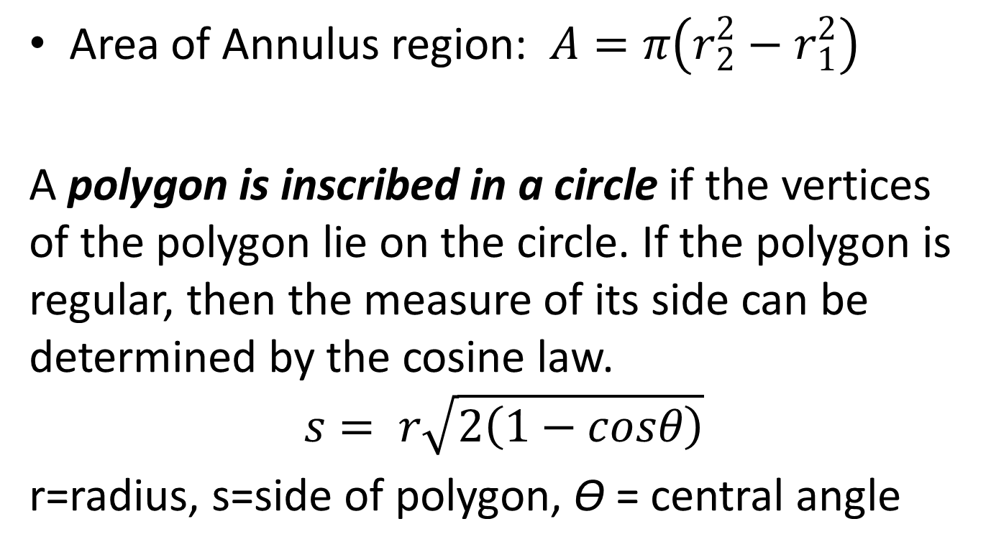
Area of Annulus region: $A=π\left(r_{2}^{2}−r_{1}^{2}\right)$
A polygon is inscribed in a circle if the vertices of the polygon lie on the circle. If the polygon is regular, then the measure of its side can be determined by the cosine law.
$$s= r\sqrt{2\left(1−cosθ\right)}$$
r=radius, s=side of polygon, ϴ = central angle
Reference: Solid Mensuration by Richard Earnhart

Slide 15
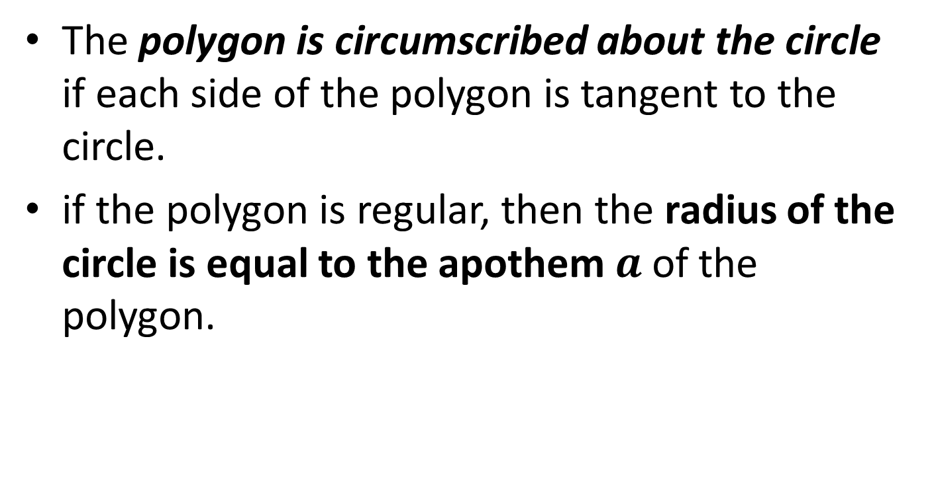
The polygon is circumscribed about the circle if each side of the polygon is tangent to the circle.
if the polygon is regular, then the radius of the circle is equal to the apothem $a$ of the polygon.
Reference: Solid Mensuration by Richard Earnhart

Slide 16
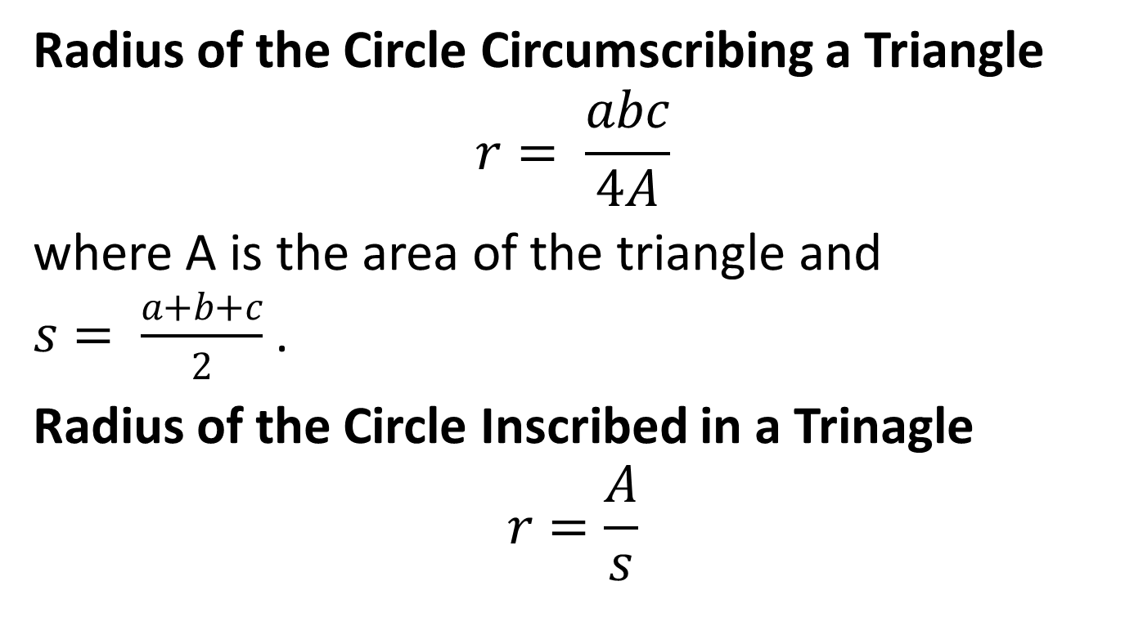
Radius of the Circle Circumscribing a Triangle
$$r= \frac{abc}{4A}$$
where A is the area of the triangle and $s= \frac{a+b+c}{2}$ .
Radius of the Circle Inscribed in a Trinagle
$$r=\frac{A}{s}$$
Reference: Solid Mensuration by Richard Earnhart

Slide 17

Area of a Cyclic Quadrilateral
$$A=\sqrt{\left(s−a\right)\left(s−b\right)\left(s−c\right)\left(s−d\right)}.$$
Where $s= \frac{a+b+c+d}{2}$ , semi-perimeter of the quadrilateral.
Reference: Solid Mensuration by Richard Earnhart

Slide 18
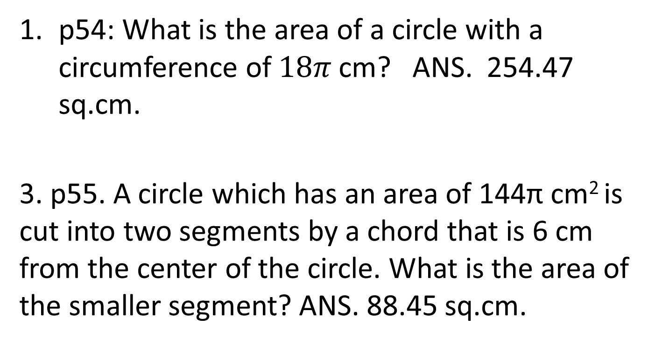
Examples
p54: What is the area of a circle with a circumference of $18π$ cm? ANS. 254.47 sq.cm.
3. p55. A circle which has an area of 144π cm² is cut into two segments by a chord that is 6 cm from the center of the circle. What is the area of the smaller segment? ANS. 88.45 sq.cm.
Reference: Solid Mensuration by Richard Earnhart

Slide 19
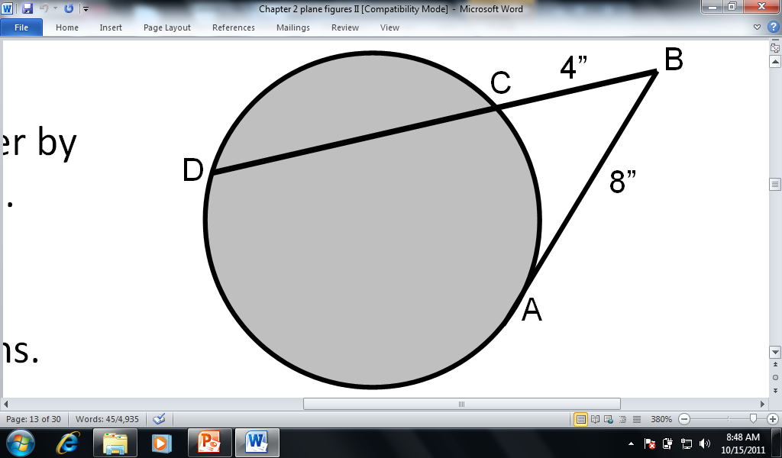
4.p55 : The tangent AB and the secant BCD are drawn to a circle from the same exterior point B. If the length of the tangent is 8 inches and the external segment of the secant is 4 inches, then what is the length of the secant?
ANS. 16 in.
Reference: Solid Mensuration by Richard Earnhart

Slide 20
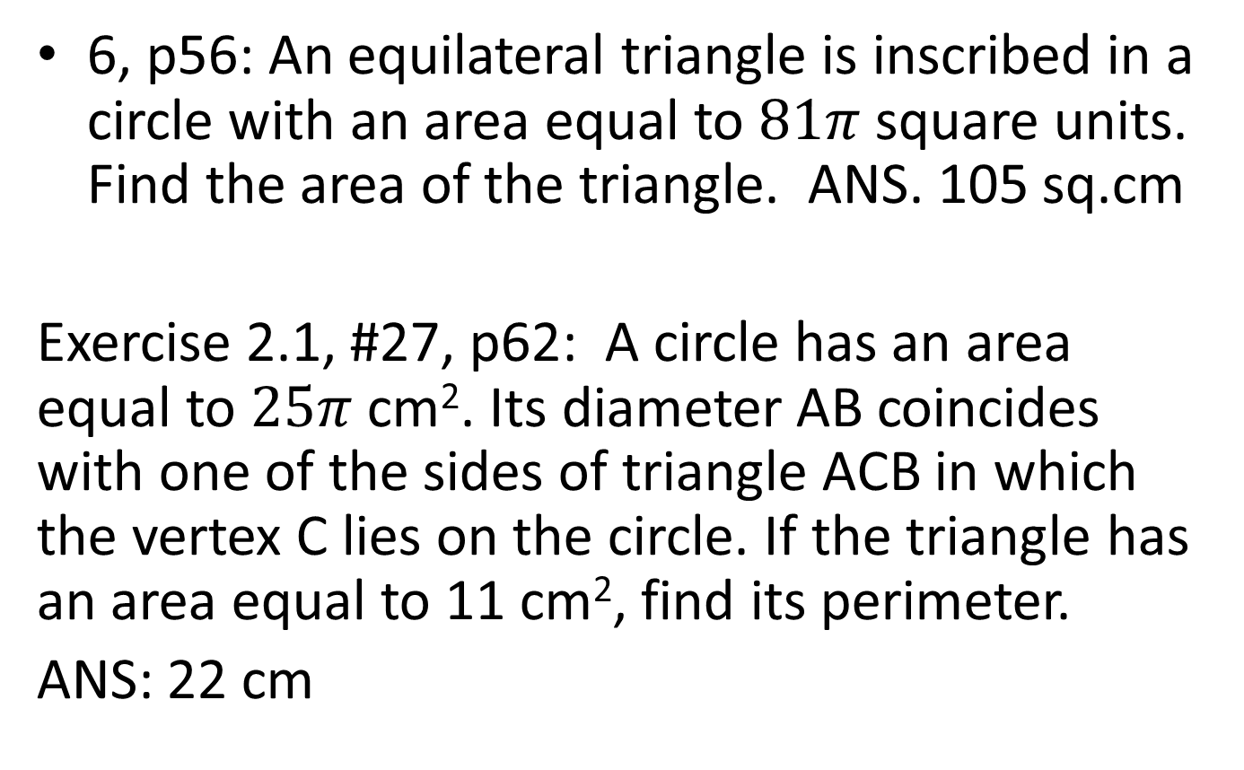
6, p56: An equilateral triangle is inscribed in a circle with an area equal to $81π$ square units. Find the area of the triangle. ANS. 105 sq.cm
Exercise 2.1, #27, p62: A circle has an area equal to $25π$ cm². Its diameter AB coincides with one of the sides of triangle ACB in which the vertex C lies on the circle. If the triangle has an area equal to 11 cm², find its perimeter.
ANS: 22 cm
Reference: Solid Mensuration by Richard Earnhart

Slide 21
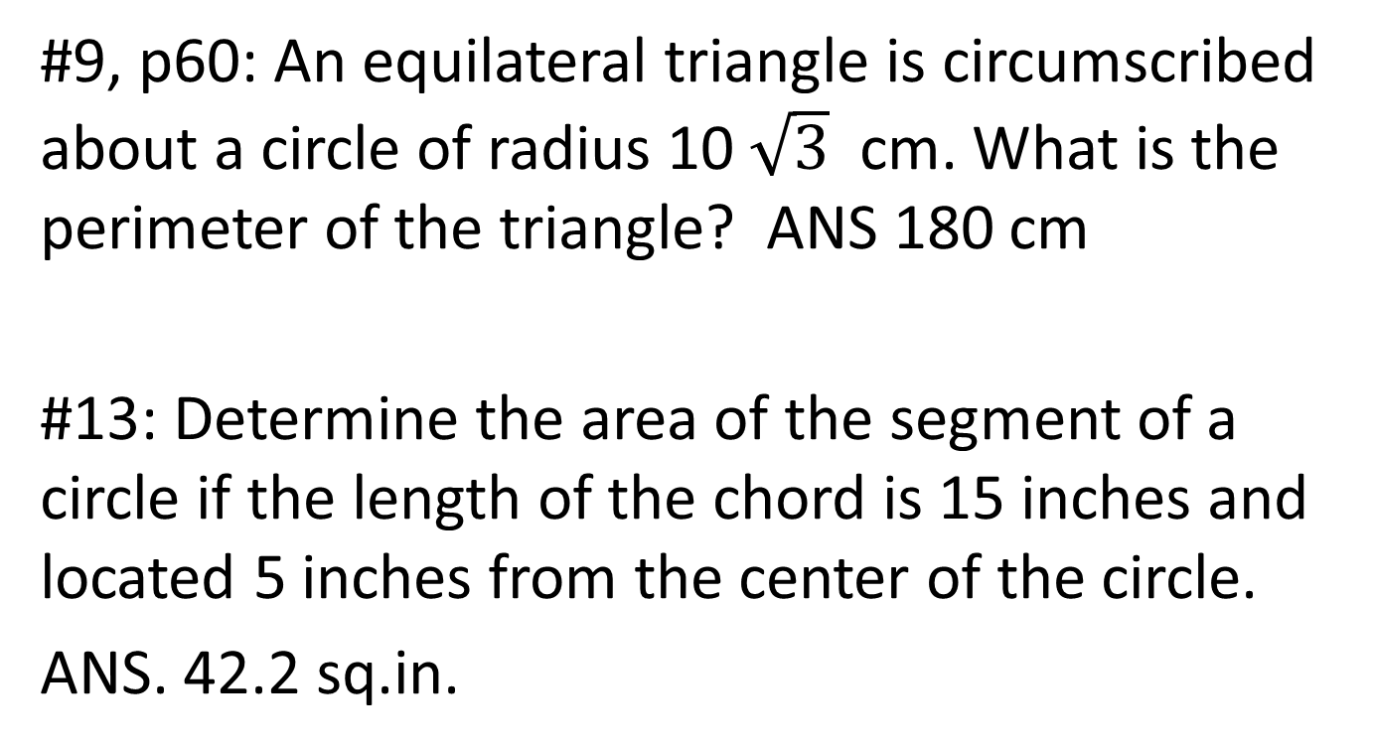
Exercises 2.1
#9, p60: An equilateral triangle is circumscribed about a circle of radius 10 $\sqrt{3}$ cm. What is the perimeter of the triangle? ANS 180 cm
#13: Determine the area of the segment of a circle if the length of the chord is 15 inches and located 5 inches from the center of the circle.
ANS. 42.2 sq.in.
Reference: Solid Mensuration by Richard Earnhart

Slide 22
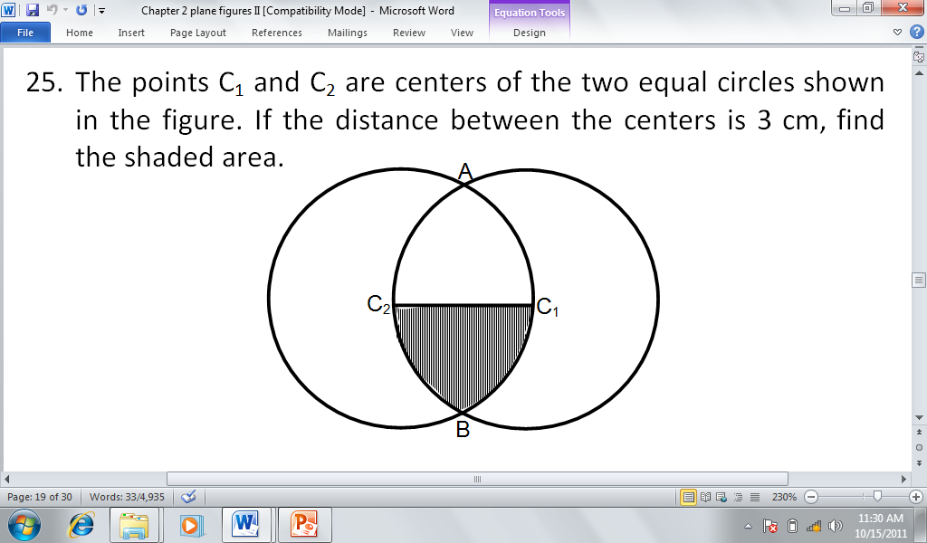

#16: Given a circle in which the diameter AB equals 4cm. If two points C and D lie on the circle and$∠ABC=18°$ and $∠BAD=36°$, find the length of the major arc CD.
NS
ANS. 5.53 sq.cm.

Slide 23
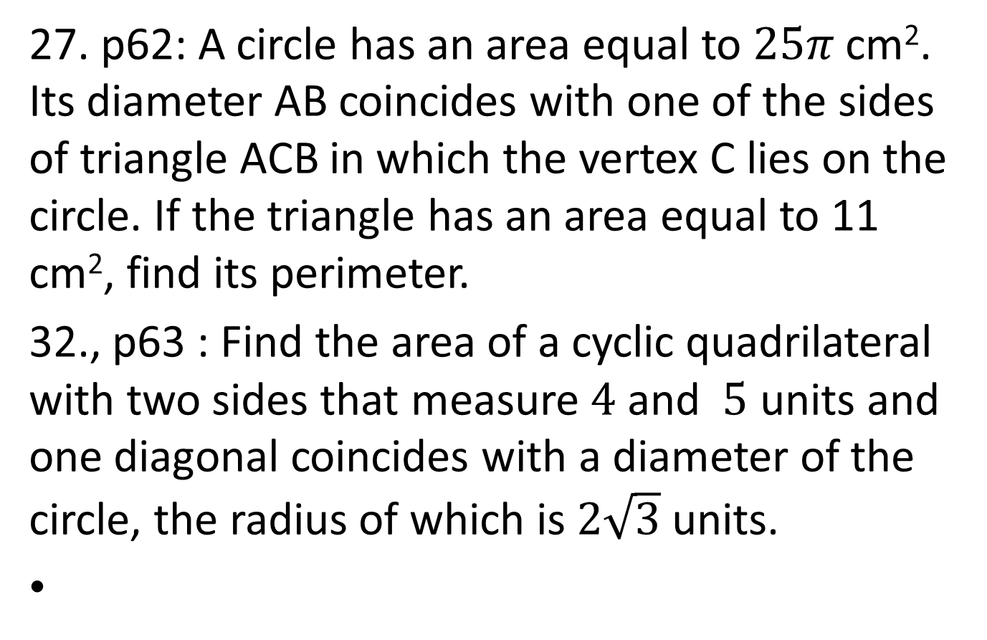
27. p62: A circle has an area equal to $25π$ cm². Its diameter AB coincides with one of the sides of triangle ACB in which the vertex C lies on the circle. If the triangle has an area equal to 11 cm², find its perimeter.
32., p63 : Find the area of a cyclic quadrilateral with two sides that measure $4$ and $5$ units and one diagonal coincides with a diameter of the circle, the radius of which is $2\sqrt{3}$ units.
Reference: Solid Mensuration by Richard Earnhart

Slide 24
A star is a star-like figure which generally consists of a polygon with triangles on its sides.
It is a regular star if the polygon involved is a regular polygon
The pentagram, also known as German or witch star, is a five-pointed regular star. The hexagram which is also known as David’s star or Solomon’s seal is a six-pointed regular star.
Reference: Solid Mensuration by Richard Earnhart

Slide 25
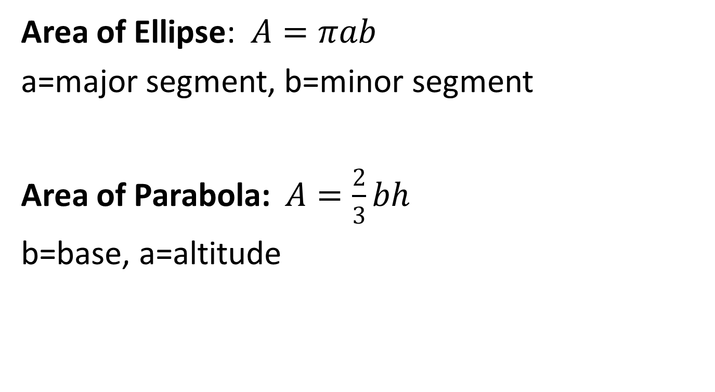
Area of Ellipse: $A=πab$
a=major segment, b=minor segment
Area of Parabola: $A=\frac{2}{3}bh$
b=base, a=altitude
Reference: Solid Mensuration by Richard Earnhart

Slide 26
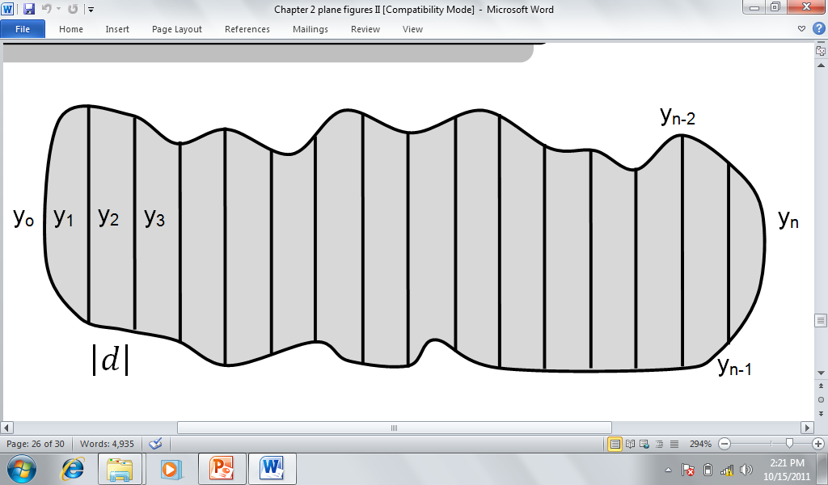

Simpson’s Rule For Irregular shaped figure.
If $y_{o}, y_{1},y_{2},…,y_{n}$($n$ is even) are the lengths of a series of parallel chords of uniform interval d then the area of the figure enclosed above is given approximately by the following formula.
$A=\frac{1}{3}d\left[\left(y_{0}+y_{n}\right)+4\left(y_{1}+y_{3}+…+y_{n−1}\right)+2\left(y_{2}+y_{4}+…+y_{n−2}\right)\right]$.
I

Slide 27
EXERCISES
In a circle with diameter of 20 cm, a regular five-pointed star touching its circumference is inscribed. Find the area of the star.
What is the area of a section bounded by a closed elliptical figure in which the major and minor segments measure 60 cm and 45 cm respectively?
What is the area of a parabola inscribed in a rectangle 30 cm long and 22 cm wide?
Reference: Solid Mensuration by Richard Earnhart

Slide 28
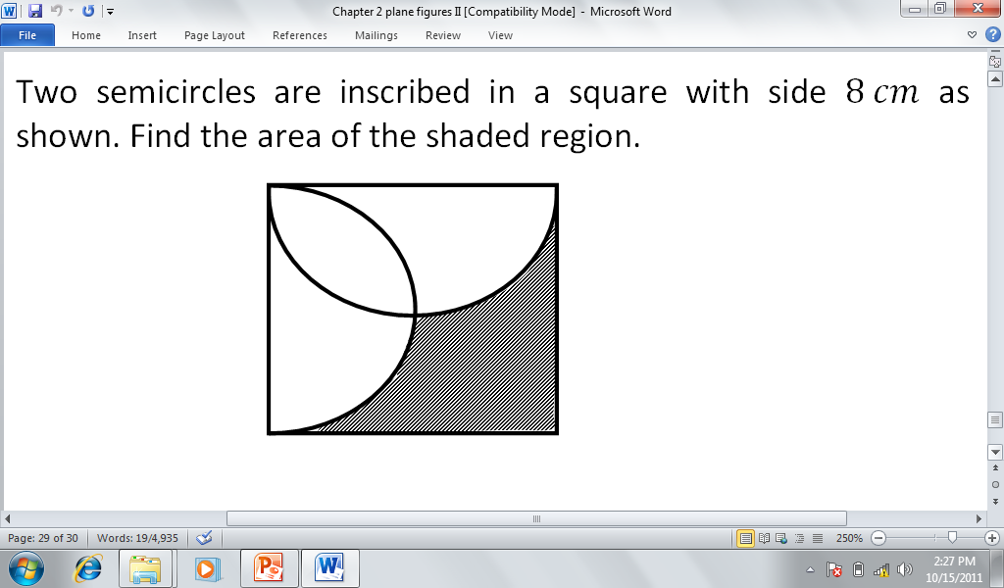

Slide 29
HOMEWORK No.2
Exercise 2.1: #5, 7, 15, 23, 29, 33 pp. 59-63
Exercise 2.2: # 8, 10 & 12 pp. 71-72

